Slide 1
Failure Mode & Effect Analysis (FMEA)

Slide 2
Objectives
FMEA Terms
What is FMEA ?
Why FMEA ?
Types of FMEA
History
FMEA Form
Who uses FMEA
Procedure
RPN
Implementation into design Process
Severity
Occurrence
Detection
Example, Limitation, Advantages

Slide 3
Fmea terms
Failure
The loss of a function under stated conditions.
A Failure Mode is:
The way in which the components, subassembly, product, input, or process could fail to perform its intended function.
Things that could go wrong.
Example: A fully fractured axle.
Effects analysis
Studying the consequences of the various failure modes to determine their severity to the customer.

Slide 4
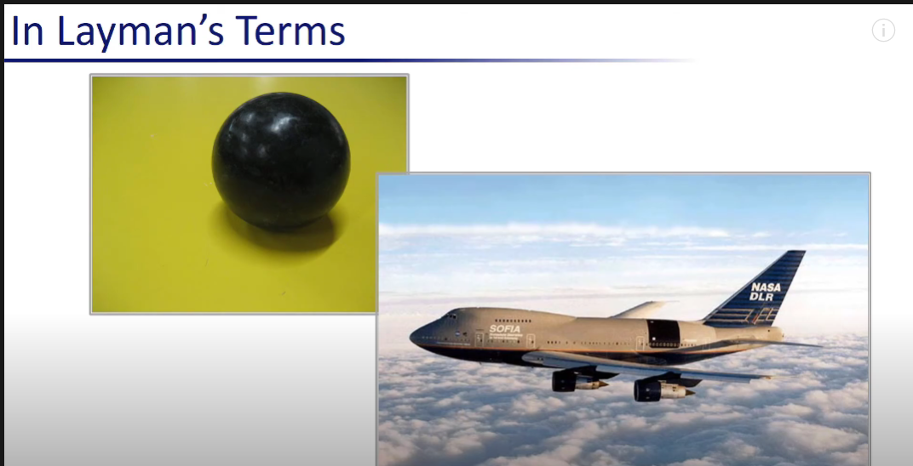
What is Fmea ?
Failure Mode and Effect Analysis (FMEA) is a step by step approach for identifying all possible failures in a design, a manufacturing or a product or service.
FMEA is an inductive reasoning (forward logic).
It is a core task in Reliability Engineering, Safety Engineering and Quality Engineering.
It is based on experience with similar product or process or based on common Physics of failure logic.
Sometimes FMEA is Extended to FMECA to indicates that criticality analysis is performed too.

Slide 5
Why fmea ???
Methodology that facilitates Process Improvement.
Improve internal and external customer satisfaction.
Focuses on prevention.
Identifying and eliminates concerns early in the development of
process or design.
FMEA may be a customer requirement (likely contractual)
FMEA may be required be an applicable
Quality Management System Standard (possibly ISO)

Slide 6
Types of FMEA
Design – focuses on component and subsystems.
Process – focuses on Manufacturing and Assembly processes.
System – focuses on global system functions.
Service – focuses on service functions.
Software – focuses on software functions.

Slide 7
History of fmea
An offshoot of 1949 Military Procedure MIL-P-1629, entitled “Procedures for Performing a Failure Mode, Effects and Criticality Analysis”
Used as a reliability evaluation technique to determine the effect of system and equipment failures.
Failures were classified according to their impact on mission success and personnel/equipment safety.
Formally developed and applied by NASA in the 1960’s to improve and verify reliability of space program hardware.
The procedures called out in MIL-STD-1629A are the most widely accepted methods throughout the military and commercial industry.

Slide 8
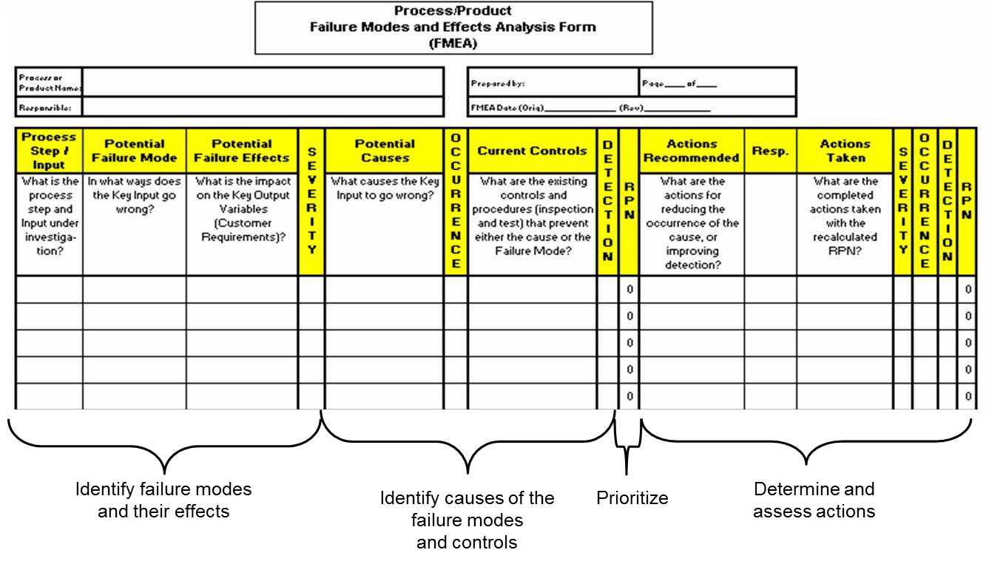
The fmea form

Slide 9
Who uses FMEA ???
Engineers Worldwide in :
Nuclear Power plant.
Aerospace
Chemical Process Industries
Automotive Industries
Healthcare
Goal has been, and remains, to prevent accident accidents from
occurring

Slide 10
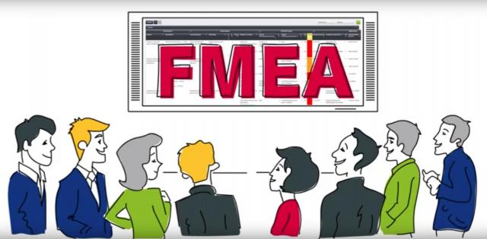
Fmea: a team tool
A Team approach is necessary.
Team leader should be familiar with FMEA.
The following should be considered for team members:
Design Engineers
Process Engineers
Materials Suppliers
Operators
Reliability
Suppliers VII.Customers

Slide 11
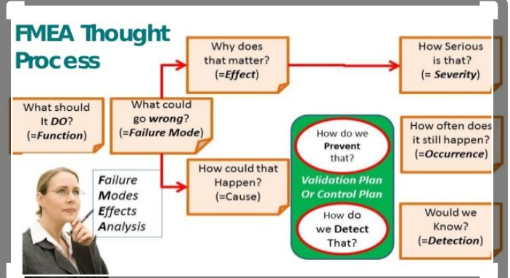
FMEA

Slide 12
Fmea Procedure
Determine failure mode for each process input.
For each failure mode, determine effects – Select a severity level for each effect.
Identify potential causes of each failure mode – Select an
occurrence level for each cause.
List current controls for each cause – Select a detection for each cause.
Calculate the Risk Priority Number (RPN).
Develop recommended action , assign responsible person and take actions.
Assign the predicted Severity, Occurrence and Detection levels and compare RPNs

Slide 13
Risk Priority number (rpn)
Severity × Occurrence × Detection = RPN
1000 is maximum and 75* is considered OK!!!
Severity (S)
Importance of the effects on customer requirements.
1 = Not sever, 10 = very sever
Occurrence (O)
Frequency with which a given cause occurs and creates failure modes.
1 = NOT Likely, 10 = Very Likely
Detection (D)
The ability of the current control scheme to detect then prevent a given causes.
1 = Easy to Detect, 10 = Not easy to Detect

Slide 14
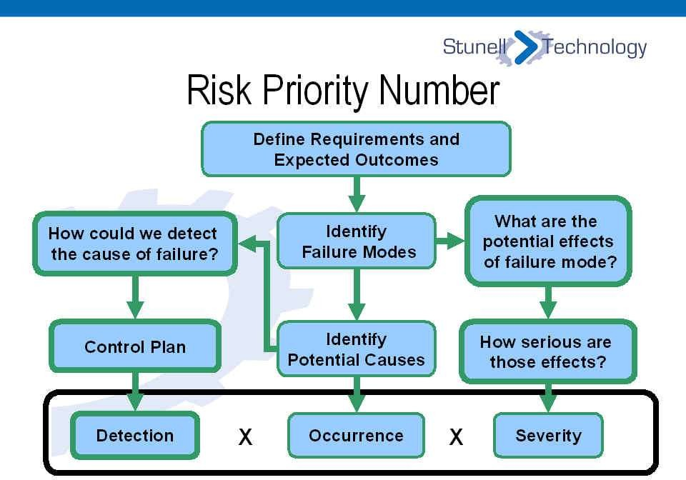
Risk Priority number (rpn)

Slide 15
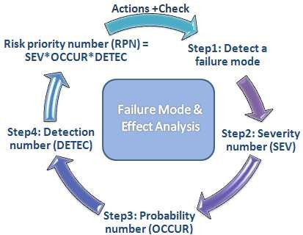
Risk Priority number (rpn)

Slide 16
Rating Scales
There are a wide variety of scoring anchors.
Two types of scales are 1-5 or 1-10.
The 1-5 scale makes it easier for the teams to decide on scores.
The 1-10 scale may allow for better precision in estimates and a
wide variation in scores.
Zero(0) Ranking not allowed for RPN Rating Scales.

Slide 17
Fmea timing
FMEA should be updated –
At the conceptual stage.
When changes are made to the design.
When new regulation are instituted.
When customer feedback indicates a problem.

Slide 18
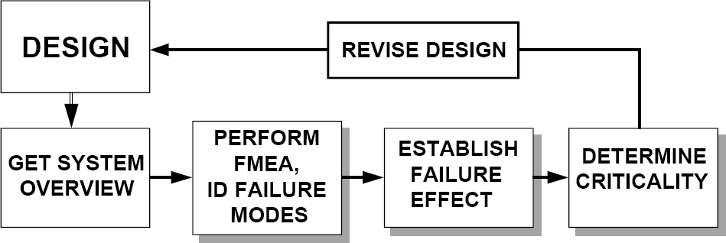
Implementation into Design process

Slide 19
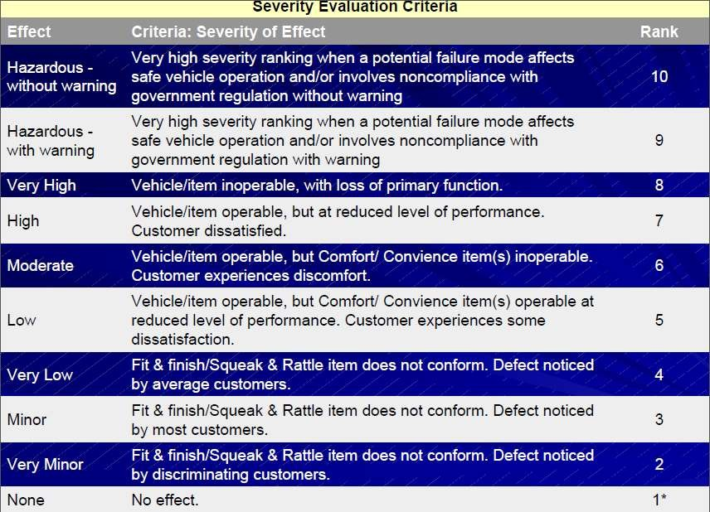

Slide 20
Ranking of Occurrence of Effect
Probability of Failure Possible Failure rates
Ranking
Very High : Persistent >/= 100 per thousand cores ^{failure} 50 per thousand cores High : Frequent failure 20 per thousand cores
10
9
8
Moderate : Occasional 10 per thousand cores ^{failure} 5 per thousand cores
7
6
2 per thousand cores
5
Low : Relatively few failure
1 per thousand cores
4
0.5 per thousand cores
3
Remote : Failure is unlikely
0.1 per thousand cores
2
</= 0.01 per thousand cores
1*

Slide 21
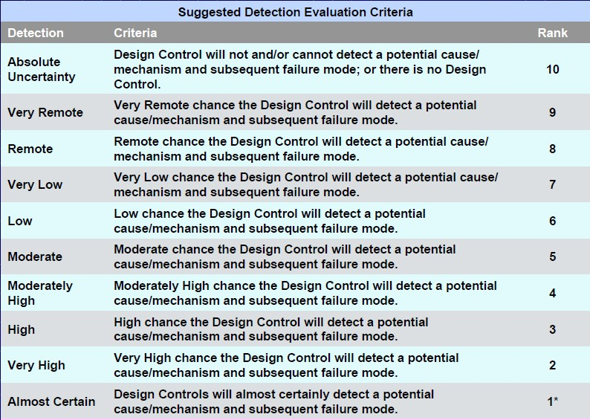

Slide 22
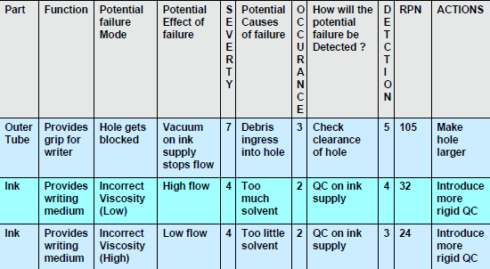
Fmea table for ball-point pen

Slide 23
Fmea for Boiler tube
Year
No. of Failure
2009
A = 24 (Assume)
2010
B = 22
2011
C = 26
2013
D = 23
2014
E =19
2015
_

Slide 24
Risk Analysis of Boiler using Failure Mode & Effect Analysis
Potential failure mode
Potential effect of failures
Potential causes
Severit Occu Detec y rrenc tion
(S) e (D) (O)
RPN Control Process Detection
Boiler Tube
1. Water leakage 2. Cooling process stop
Unit had shut down
Water level not maintai ned
1. Corrosion
X = 9
(let)
Y = 7
(let)
Z = 5
(let)
315 Water leakage
Scale
formation
Extremely combustion
Creep
failure
Poor water Circulation
Thickness of tube
wall
Thermal stress
Increased tube
strain
Alarms

Slide 25
Advantages
Enhance design and manufacturing efficiencies
Minimize exposure to product failures
Augment business records
Improve “bottom line” results
Add to customer satisfaction
Reliability also Improve

Slide 26
Limitation
Employee training requirements
Initial impact on product and manufacturing schedules
Financial impact required to upgrade design, manufacturing, and
process equipment and tools

